Slide 1

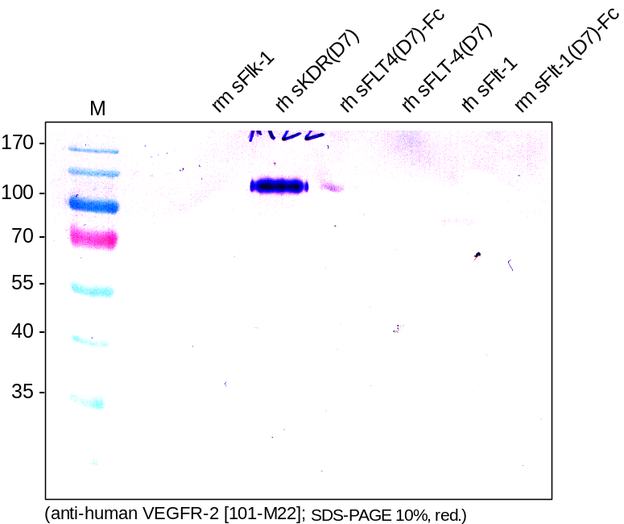
ReliaTech GmbH
Mouse anti-human VEGFR-2/KDR (#EWC)
(Cat #101-M22)
Figure 1. Western analysis with different recombinant soluble VEGF receptor proteins using a monoclonal anti-human VEGFR-2/KDR antibody [Cat# 101-M22]. There is no cross reactivity visible with mouse sFlk-1, human sFLT-4 and human and mouse sFlt-1.
http://www.reliatech.de / orders@reliatech.de

